Slide 1
Classifying Stars using Artificial Intelligence
Rosie Fasullo
Notes:
We classify stars to learn something about their physical properties, artificial intelligence is a branch of computer science that focuses on allowing computers to make decisions like and exhibit behavior similar to a human

Slide 2
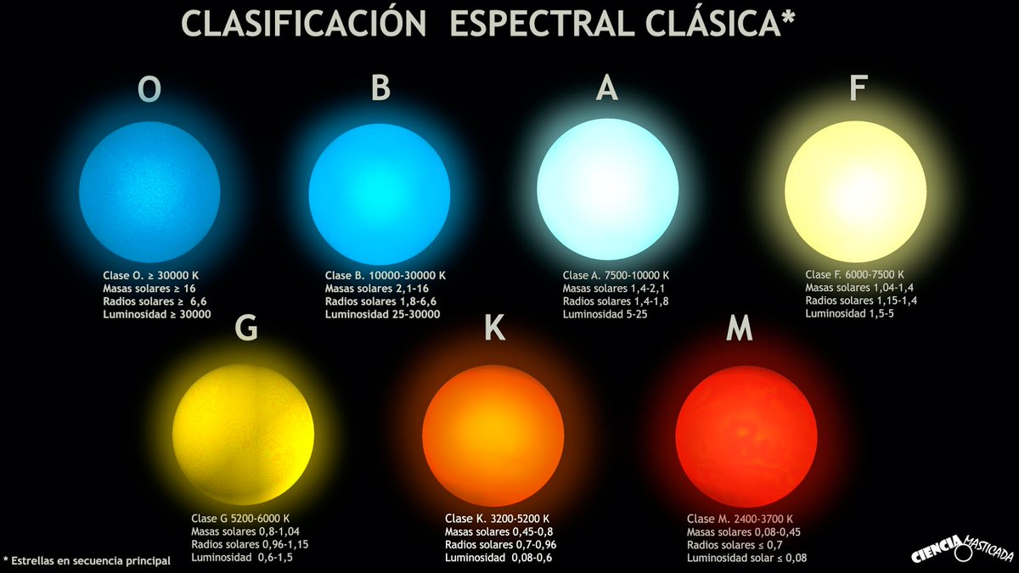
Spectral Type corresponds to temperature
Type O: >30000K
(Hottest)
Type B: 10000-30000 K
Type A: 7500-10000 K
Type F: 6000-7500 K
Type G: 5200-6000 K
(The Sun)
Type K: 3200-5200 K
Type M: 2400-3700 K
(Coolest)
http://frasesparatatuajes.club/estrellas-nombres/25496/

Slide 3
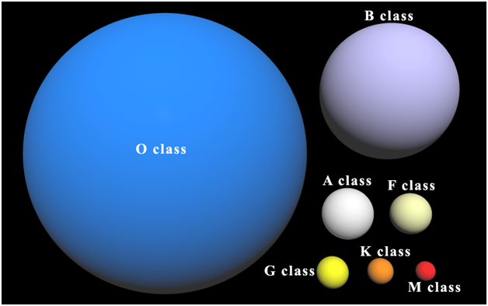
Luminosity Class Corresponds to size
Class II
Class I
Class III
Class IV
Class V
(The Sun)
http://www.guildcompanion.com/scrolls/2011/oct/ssg03.html

Slide 4
Stellar Classifications are broken down into two parts
B3 IV
Spectral Type
Luminosity Class
Subtype

Slide 5
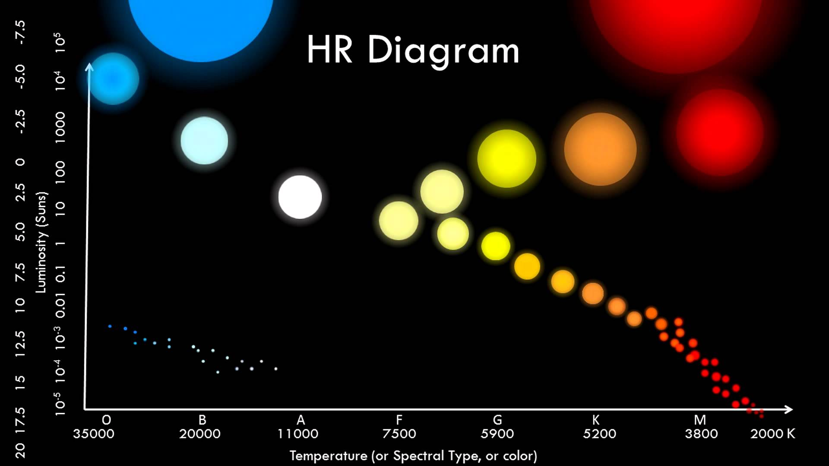
Hertzsprung-Russell Diagram
The Sun
https://i.ytimg.com/vi/588oz17Xj8o/maxresdefault.jpg

Slide 6
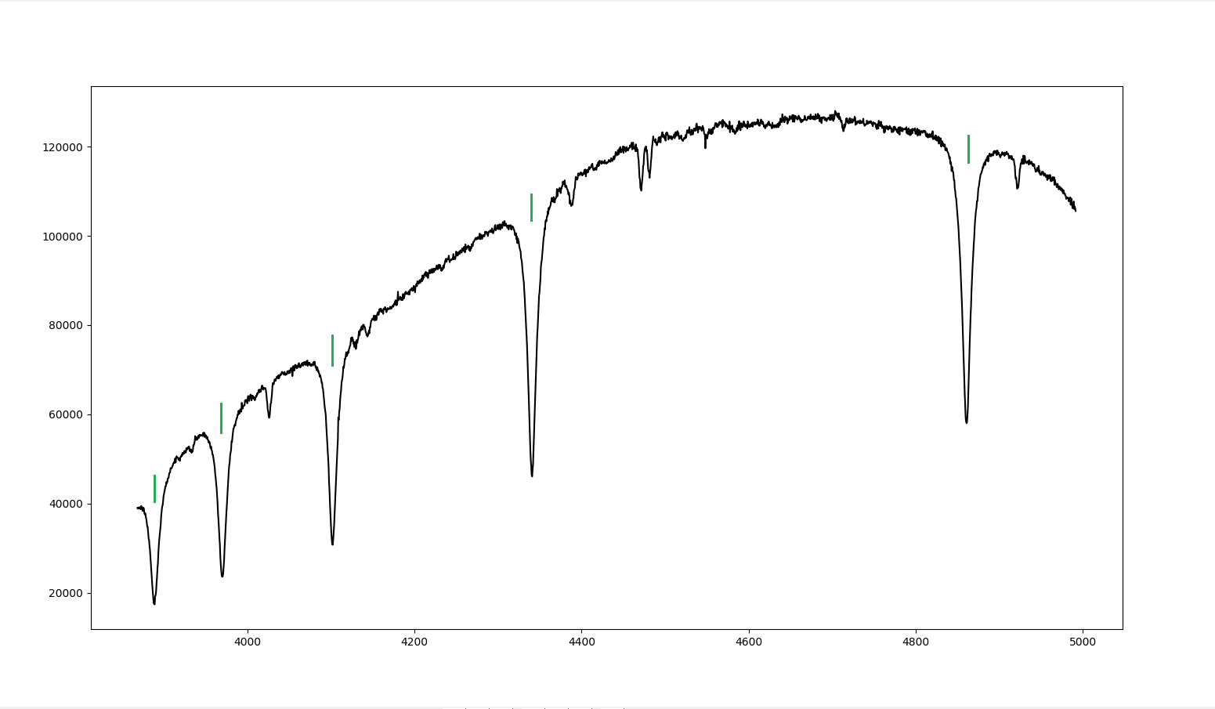
A spectrum is a continuum of light emitted by an object
HD023288
120000
100000
80000
Intensity (ADU)
60000
40000
20000
4000
4200
4400
4600
4800
5000
Wavelength (Å)
Notes:
Data comes from the Adams Observatory

Slide 7
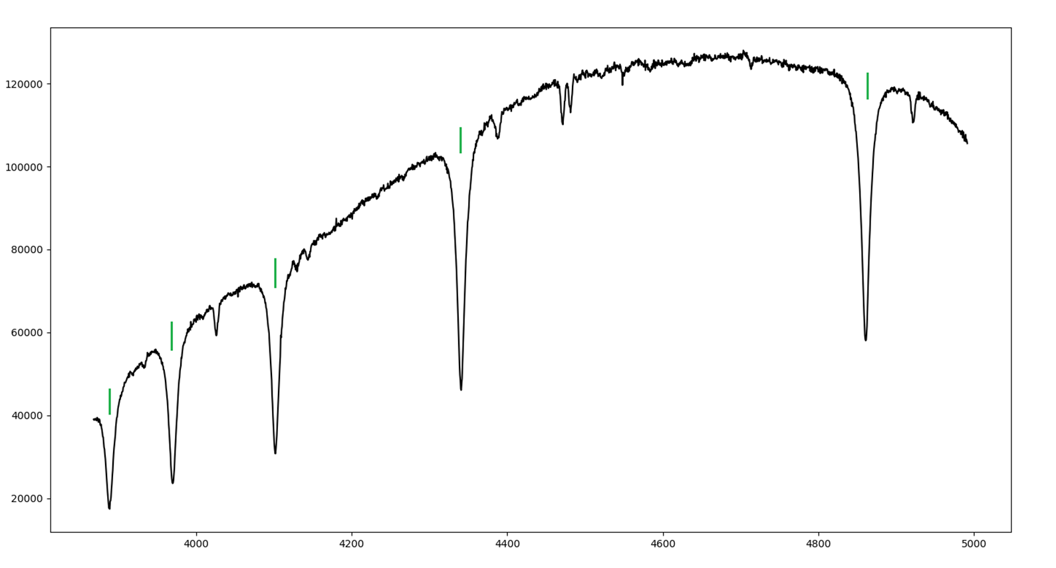
The most important absorption lines are the balmer hydrogen lines
HD023288
Hβ
120000
Hγ
100000
80000
Hδ
Intensity (ADU)
Hε
60000
H8
40000
20000
4000
4200
4400
4600
4800
5000
Wavelength (Å)
Notes:
H alpha is not shown here it is in the red

Slide 8
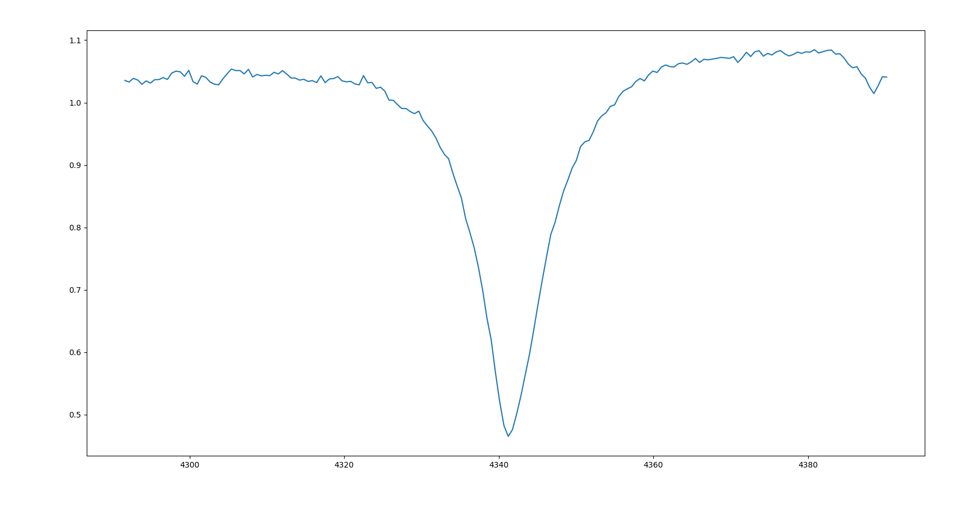
Spectral type is determined by Strength of the hydrogen lines
Hγ
1.2
1.1
1.0
0.9
Relative Intensity (ADU)
0.8
0.7
A3 V
0.6
0.5
4300
4320
4340
4360
4380
Wavelength (Å)
Notes:
(3 Slides) Start with A3V, talk about the basics, then add in B3V then add 09V, more Ionized (Don’t add this to slide, just know it in your brain)

Slide 9
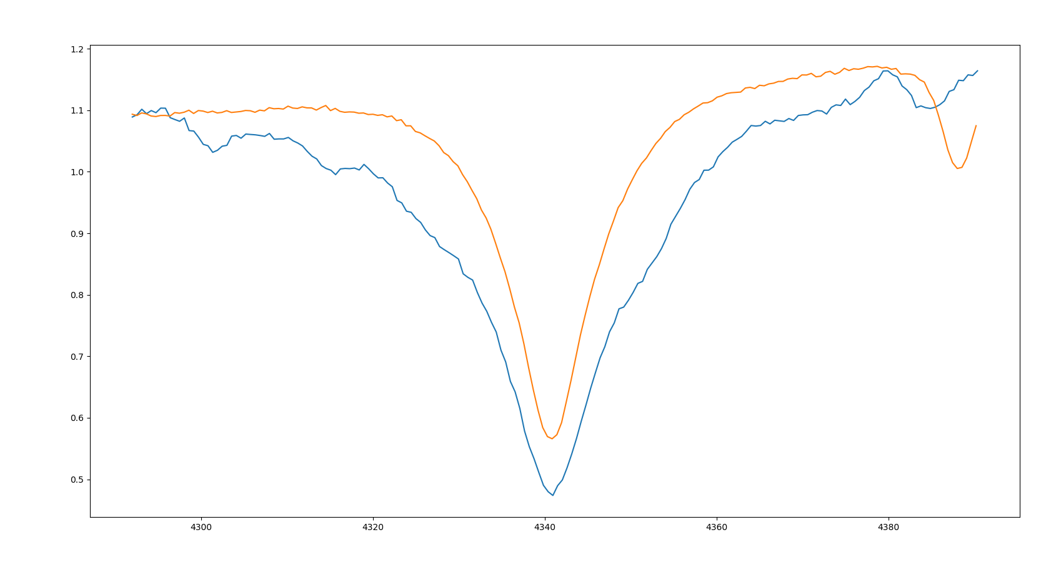
Spectral type is determined by Strength of the hydrogen lines
Hγ
1.2
1.1
1.0
0.9
Relative Intensity (ADU)
0.8
B3 V
0.7
A3 V
0.6
0.5
4300
4320
4340
4360
4380
Wavelength (Å)
Notes:
(3 Slides) Start with A3V, talk about the basics, then add in B3V then add 09V, more Ionized (Don’t add this to slide, just know it in your brain)

Slide 10
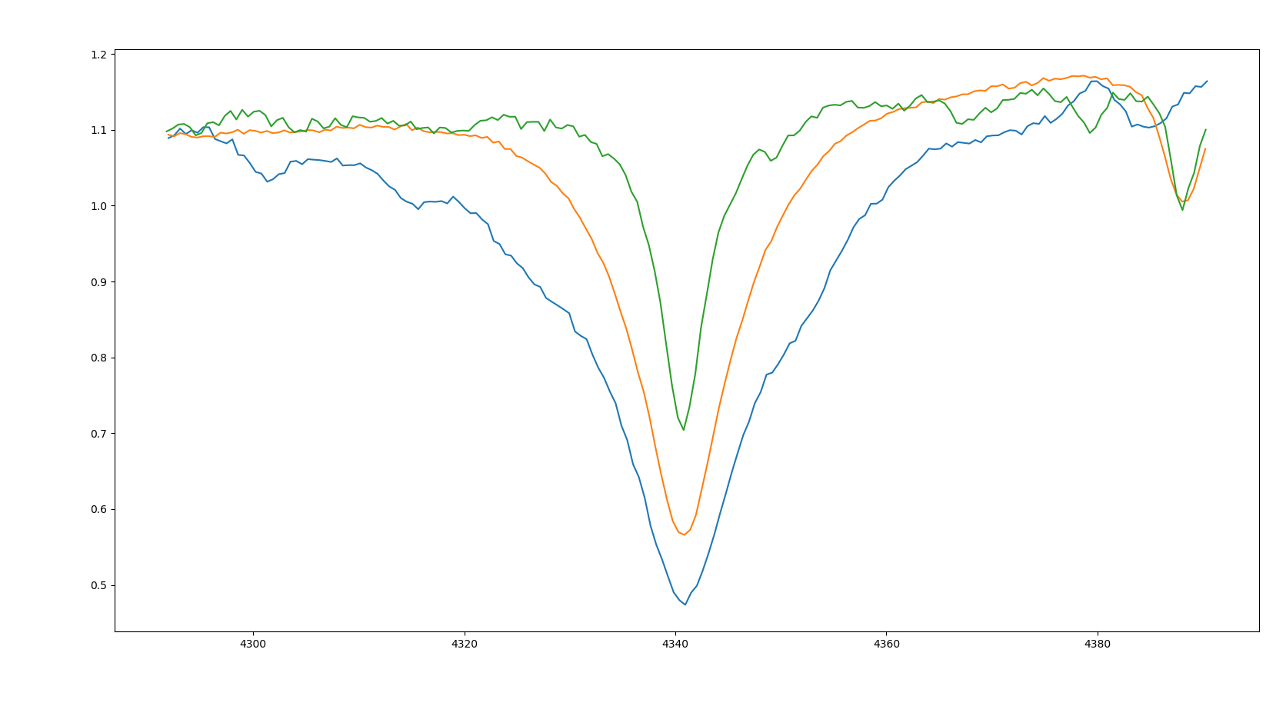
Spectral type is determined by Strength of the hydrogen lines
Hγ
1.2
O9 V
1.1
1.0
0.9
Relative Intensity (ADU)
0.8
B3 V
0.7
A3 V
0.6
0.5
4300
4320
4340
4360
4380
Wavelength (Å)
Notes:
(3 Slides) Start with A3V, talk about the basics, then add in B3V then add 09V, more Ionized (Don’t add this to slide, just know it in your brain)

Slide 11
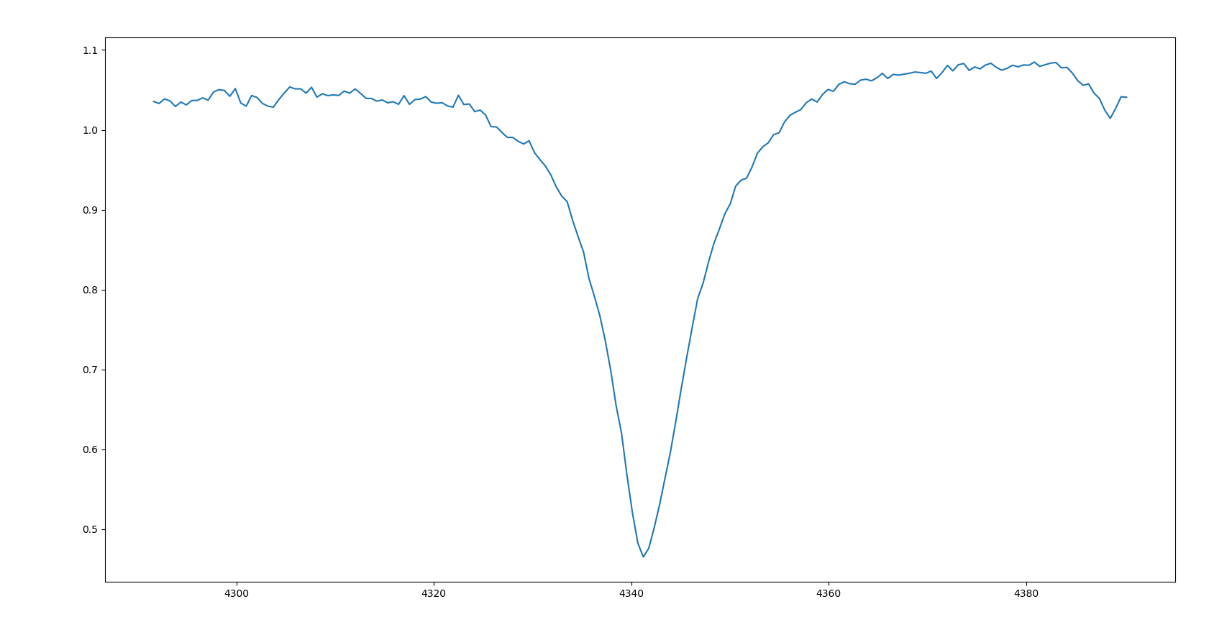
Luminosity class is determined by the shape of the hydrogen wings
Hγ
1.1
B7 III
1.0
0.9
0.8
Relative Intensity (ADU)
0.7
0.6
0.5
4300
4320
4340
4360
4380
Wavelength (Å)
Notes:
Drop the subgiant (IV)

Slide 12
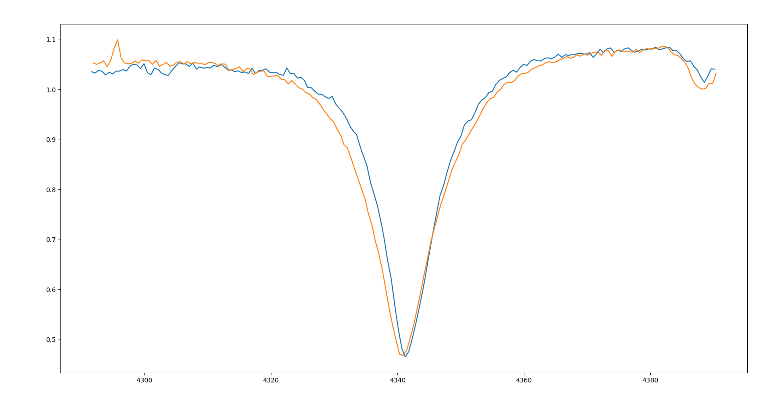
Luminosity class is determined by the shape of the hydrogen wings
Hγ
1.1
B7 III
1.0
0.9
0.8
Relative Intensity (ADU)
B7 V
0.7
0.6
0.5
4300
4320
4340
4360
4380
Wavelength (Å)
Notes:
Drop the subgiant (IV)

Slide 13
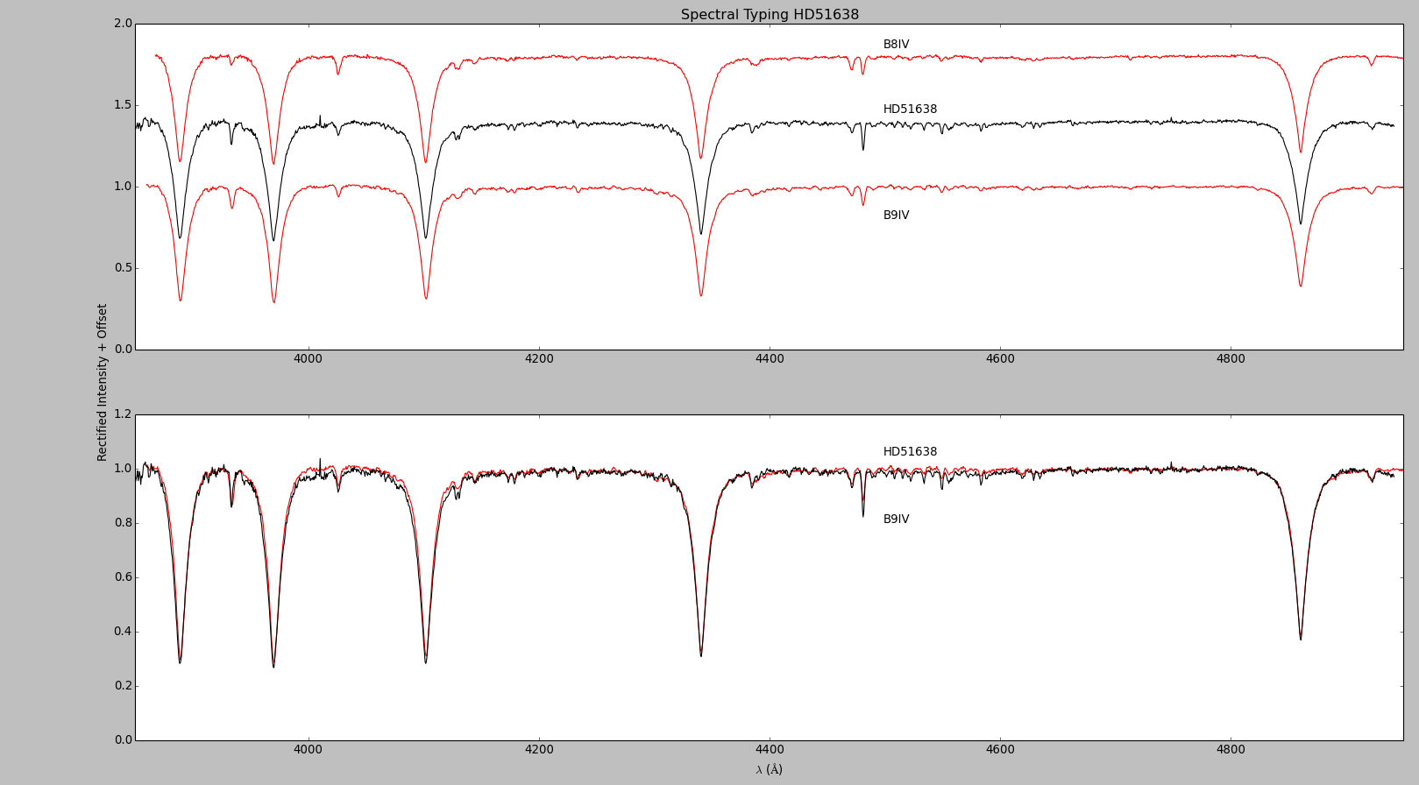
Stars are usually classified by comparing their spectra
2.0
1.5
B8 IV
HD51638
1.0
B9 IV
0.5
0.0
4000
4200
4400
4800
Rectified Intensity + Offset
4600
1.2
HD51638
1.0
0.8
B9 IV
0.6
0.4
0.2
0.0
4200
4400
4800
4000
4600
Notes:
Add labels to make it legible, everyone was taken at the Adams Observatory

Slide 14
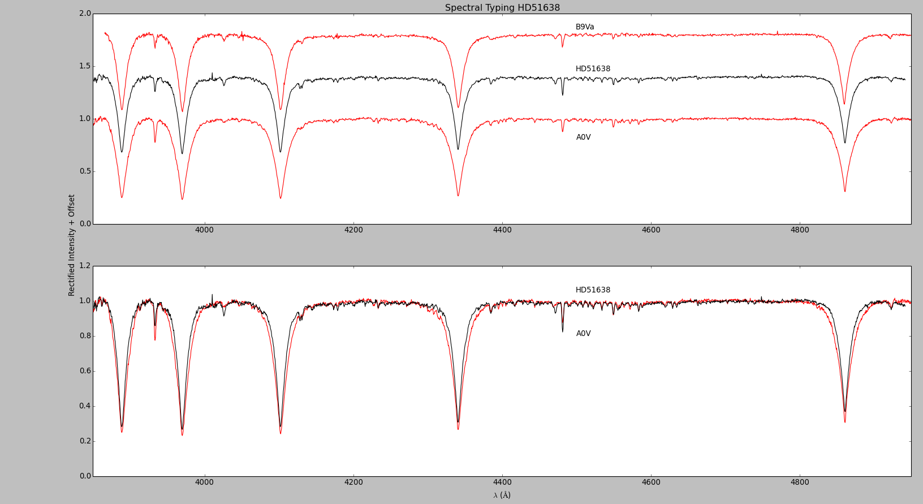
Stars are usually classified by comparing their spectra
2.0
1.5
B9 Va
HD51638
1.0
AO V
0.5
0.0
4000
4200
4400
4800
4600
Rectified Intensity + Offset
1.2
HD51638
1.0
0.8
AO V
0.6
0.4
0.2
0.0
4000
4200
4400
4600
4800

Slide 15

A computer can work much faster than a human
https://becominghuman.ai/what-is-artificial-intelligence-ai-4bde325e5462

Slide 16
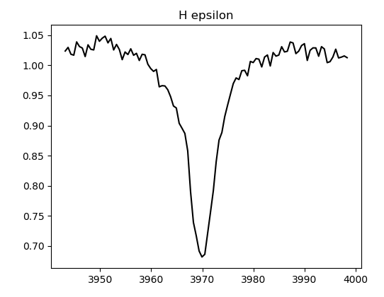
The Lorentz distribution describes the shape and strength of the hydrogen lines
Intensity (ADU)
Wavelength (Å)
Notes:
(3 slides) just data, then the curves, then the formula (label the stuff) {This might be more than one slide}

Slide 17
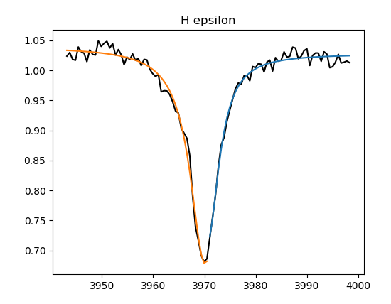
The Lorentz distribution describes the shape and strength of the hydrogen lines
Intensity (ADU)
Lorentz Curve
Wavelength (Å)
Notes:
(3 slides) just data, then the curves, then the formula (label the stuff) {This might be more than one slide}

Slide 18
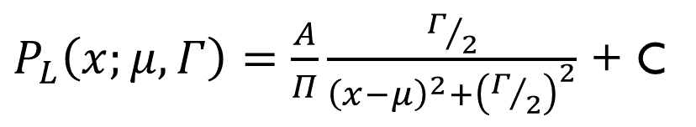
The Lorentz distribution describes the shape and strength of the hydrogen lines
$P_{L}\left(x;μ,Γ\right)=\frac{A}{Π}\frac{Γ/2}{{\left(x−μ\right)}^{2}+{\left(Γ/2\right)}^{2}}$ + C
Intensity (ADU)
Lorentz Curve
Wavelength (Å)
Notes:
(3 slides) just data, then the curves, then the formula (label the stuff) {This might be more than one slide}

Slide 19
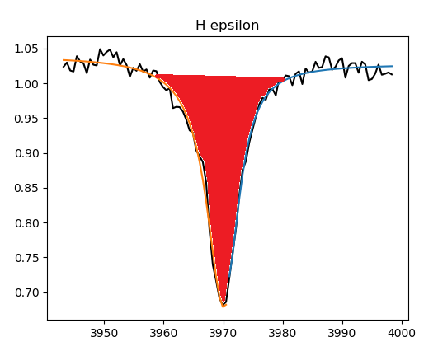
The Lorentz distribution describes the shape and strength of the hydrogen lines
Line Strength
$P_{L}\left(x;μ,Γ\right)=\frac{A}{Π}\frac{Γ/2}{{\left(x−μ\right)}^{2}+{\left(Γ/2\right)}^{2}}$ + C
Intensity (ADU)
Wavelength (Å)
Notes:
(3 slides) just data, then the curves, then the formula (label the stuff) {This might be more than one slide}

Slide 20
The Lorentz distribution describes the shape and strength of the hydrogen lines
Full Width Half Maximum
$P_{L}\left(x;μ,Γ\right)=\frac{A}{Π}\frac{Γ/2}{{\left(x−μ\right)}^{2}+{\left(Γ/2\right)}^{2}}$ + C
Intensity (ADU)
Wavelength (Å)
Notes:
(3 slides) just data, then the curves, then the formula (label the stuff) {This might be more than one slide}

Slide 21
The Lorentz distribution describes the shape and strength of the hydrogen lines
$P_{L}\left(x;μ,Γ\right)=\frac{A}{Π}\frac{Γ/2}{{\left(x−μ\right)}^{2}+{\left(Γ/2\right)}^{2}}$ + C
Intensity (ADU)
Line Center
Wavelength (Å)
Notes:
(3 slides) just data, then the curves, then the formula (label the stuff) {This might be more than one slide}

Slide 22
The Lorentz distribution describes the shape and strength of the hydrogen lines
Height of Continuum
$P_{L}\left(x;μ,Γ\right)=\frac{A}{Π}\frac{Γ/2}{{\left(x−μ\right)}^{2}+{\left(Γ/2\right)}^{2}}$ + C
Intensity (ADU)
Wavelength (Å)
Notes:
(3 slides) just data, then the curves, then the formula (label the stuff) {This might be more than one slide}

Slide 23
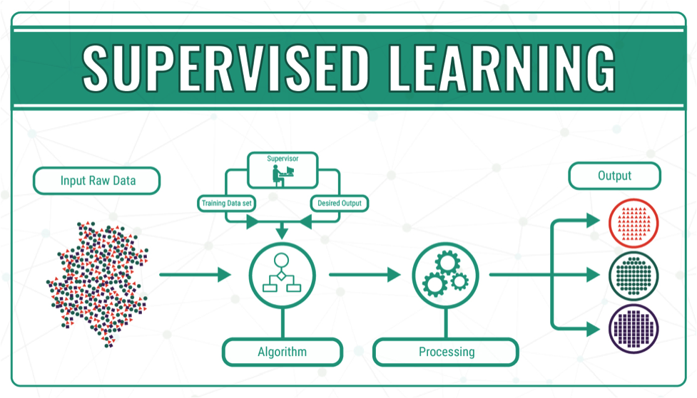
https://datafloq.com/read/machine-learning-explained-understanding-learning/4478
Notes:
https://datafloq.com/read/machine-learning-explained-understanding-learning/4478

Slide 24
Decision trees are used to group items by classification based on a set of features
Spectrum to Be Classified
Hε R Strength
Hβ R Strength
Hε L Strength
Hβ R Strength
Hδ R Strength
Hγ R Strength
Hε L Gamma
A
B
B
O
A
O
B
A

Slide 25
A Random forest classifier uses a series of randomly generated decision Trees
Spectrum to Be Classified
Random Forest
Tree-1
Tree-2
Tree-N
…
Class A
Class B
Class A
Majority Vote
Class A

Slide 26
four different labelling schemes were employed
Complete Classification | Complete Spectral Type | Spectral Type With Only Whole Number | Spectral Type Without Numerical Subtype
O9.5IV | O9.5 | O9 | O
B0.2III | B0.2 | B0 | B
A2III | A2 | A2 | A

Slide 27
four different labelling schemes were employed
Complete Classification | Complete Spectral Type | Spectral Type With Only Whole Number | Spectral Type Without Numerical Subtype
O9.5IV | O9.5 | O9 | O
B0.2III | B0.2 | B0 | B
A2III | A2 | A2 | A

Slide 28
four different labelling schemes were employed
Complete Classification | Complete Spectral Type | Spectral Type With Only Whole Number | Spectral Type Without Numerical Subtype
O9.5IV | O9.5 | O9 | O
B0.2III | B0.2 | B0 | B
A2III | A2 | A2 | A

Slide 29
four different labelling schemes were employed
Complete Classification | Complete Spectral Type | Spectral Type With Only Whole Number | Spectral Type Without Numerical Subtype
O9.5IV | O9.5 | O9 | O
B0.2III | B0.2 | B0 | B
A2III | A2 | A2 | A

Slide 30
four different labelling schemes were employed
Complete Classification | Complete Spectral Type | Spectral Type With Only Whole Number | Spectral Type Without Numerical Subtype
O9.5IV | O9.5 | O9 | O
B0.2III | B0.2 | B0 | B
A2III | A2 | A2 | A

Slide 31
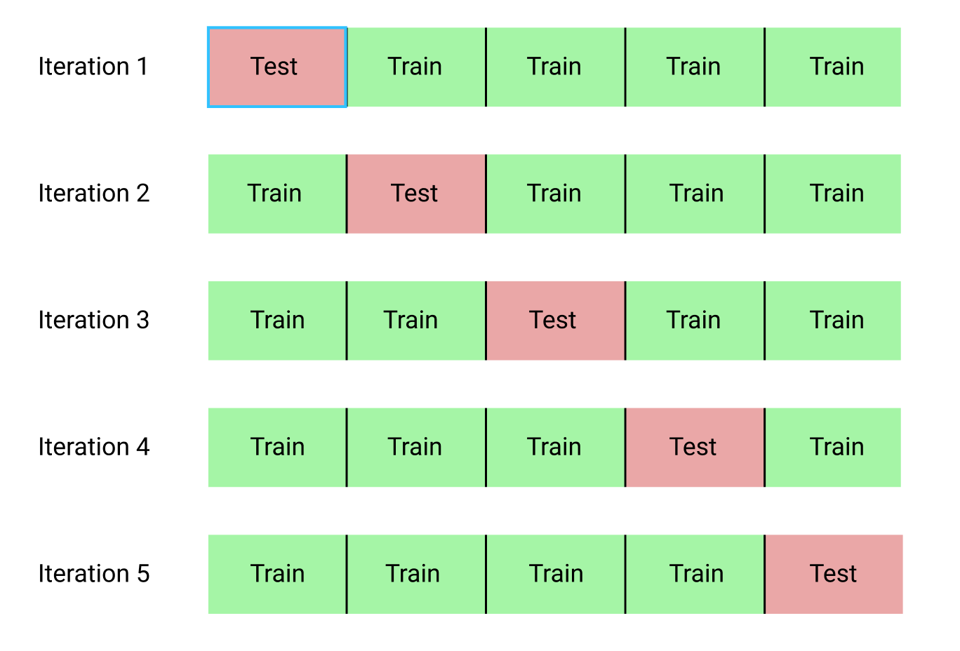
Cross validation is used to determine the true accuracy of a machine learning algorithm
http://i.imgur.com/gu3Fa6w.png

Slide 32
Classifier accuracy
Classifier Type | Accuracy | Type Version
RFC w/ K-Fold Cross-validation | 79% | Alpha Only (A, B, 0)
RFC w/ K-Fold Cross-validation | 28% | Whole Num (A2, B0, O9)
RFC w/ K-Fold Cross-validation | 23% | No Lumin (A2, B0.2, O9.5)
RFC w/ K-Fold Cross-validation | 24% | Complete (A2III, B0.2III, O9.5IV)

Slide 33
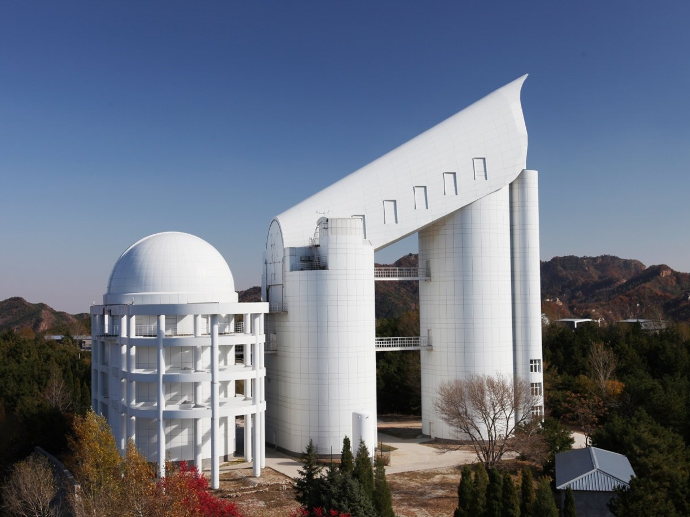
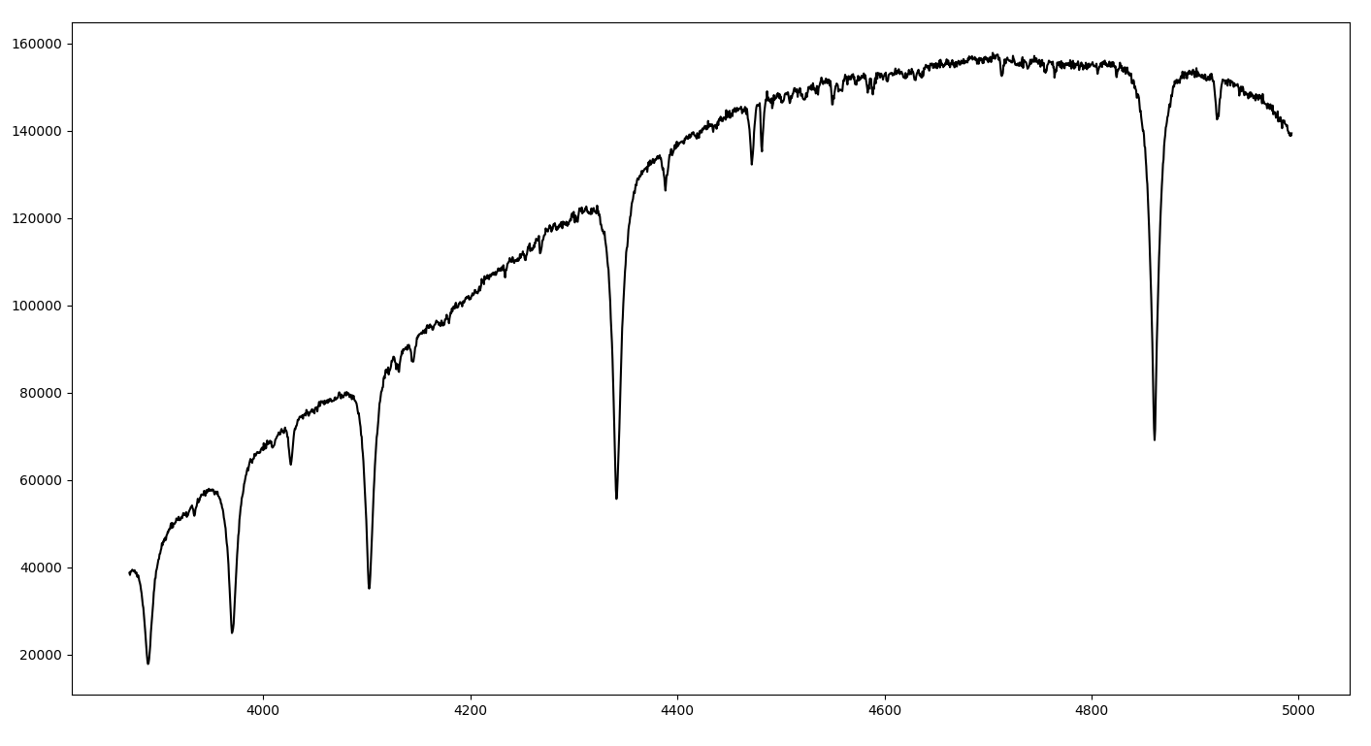
Future Works
Create new spectra from old spectra
LAMOST data from the Chinese Academy

Slide 34
Future Works
HD023288
He I
He I
He I
He I
120000
100000
He I
80000
He I
Intensity (ADU)
60000
40000
20000
4000
4200
4400
4600
4800
5000
Wavelength (Å)

Slide 35
A huge thank you to:
The John and Patricia Adams Foundation
Austin College
David Whelan
Michael Higgs

Slide 36
Questions?

